Slide 1
Welcome to our class

Slide 2
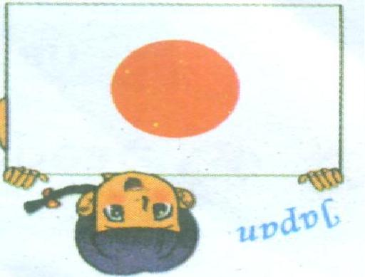
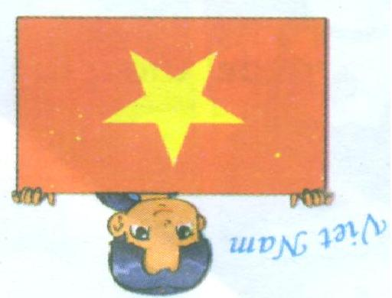
Check previous lesson
a
b
c
d
This is Mai.
She is from Viet Nam
She is Vietnamese
This is Tony.
He is from Australia
He is Australian
This is Akiko.
She is from Japan
She is Japanese
This is Hakim
He is from Malaysia.
He is Malaysian

Slide 3
Thursday, September 14th , 2017
Unit 2: I’m from Japan
Lesson 3
Notes:
3

Slide 4
Unit 2: I’m from Japan
Lesson 3
I. Listen and repeat
J Japan I’m from Japan
v Vietnamese I’m Vietnamese
* Find some words begin with j and v

Slide 5
Unit 2: I’m from Japan
Lesson 3
II. Listen and tick.Then say aloud.
1.a Japan b. Japanese
√
2.a Viet Nam b. Vietnamese
√
* Read all the sentences about two people

Slide 6
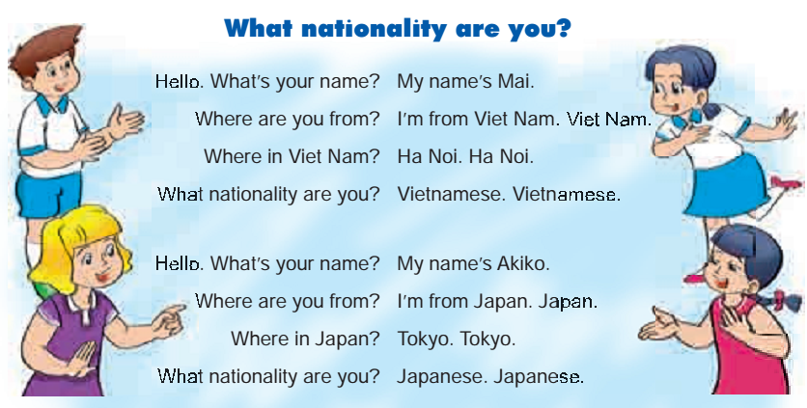
III. Let’s chant.

Slide 7
GOODBYE
Thank you for your attention!

